Slide 1
Chapter 6
Week 5
SNMPv2

Slide 2
Objectives
Chapter 6 SNMP Management: SNMPv2
Community-based security
SNMPv2 enhancements
Additional messages
Formalization of SMI
Get-bulk request and information-request
SNMP MIB modifications
Incompatibility with SNMPv1
Proxy server
Bilingual manager
Chapter 6: Sections
Chapter Overview
6.1 MAJOR CHANGES IN SNMPv2
Chapter Summary

Slide 3
MAJOR CHANGES IN SNMPv2
Several significant changes were introduced in SNMPv2. One of the most significant changes was to improve the security function that SNMPvl lacked. The security function continued to be implemented on an administrative framework based on the community name and the same administrative framework as in SNMPvl was adopted for SNMPv2.
SNMPv2 Working Group has presented a summary of the community-based Administrative Framework for the SNMPv2 framework. There are significant differences between the two versions of SNMP, and unfortunately version 2 is not backward compatible with version 1.
The basic components of network management in SNMPv2 are the same as version 1 . They are the agent and the manager, both performing the same functions. The manager-to-manager communication, shown in Figure 4.8, is formalized in version 2 by adding an additional message. Thus, the organizational model in version 2 remains essentially the same. In spite of the lack of security enhancements, major improvements to the architecture have been made in SNMPv2.
Bulk Data Transfer Message: Two significant messages were added. The first is the ability to request and receive bulk data using the get-bulk message. This speeds up the get-next-request process and is especially useful to retrieve data from tables.
Manager-to-Manager Message: The second additional message deals with interoperability between two network management systems. This extends the communication of management messages between management systems and thus makes network management systems interoperable.
Structure of Management Information (SMI): In SNMPvl, SMI is defined as STD 16, in SMIv2 is divided into three parts: module definitions, object definitions, and trap definitions. An ASN. 1 macro, MODULE-IDENTITY, is used to define an information module. It concisely conveys the semantics of the information module. The OBJECT-TYPE macro defines the syntax and semantics of a managed object. The trap is also termed notification and is defined by a NOTIFICATION-TYPE macro.
Cont.

Slide 4
MAJOR CHANGES IN SNMPv2 cont.
Textual Conventions are designed to help define new data types. They are also intended to make the semantics consistent and clear to the human reader. Although new data types could have been created using new ASN.l class and tag, the decision was made to use the existing defined class types and apply restrictions to them.
Conformance Statements help the customer objectively compare features of various products.
Compliance defines a minimum set of capabilities.
Table Enhancements: Using a newly defined columnar object with a Syntax clause, RowStatus, conceptual rows could be added to or deleted from an aggregate object table. Further, a table can be expanded by augmenting another table to it, which is helpful in adding additional columnar objects to an existing aggregate object.
MIB Enhancements: In SNMPv2, the Internet node in the MIB has two new subgroups: security and snmpV2, as shown in Figure 6. 1.There are significant changes to System and SNMP groups of version I. There are changes to the System group made under mib-2 node in the MIB. The SNMP entities in version 2 are a hybrid, with some entities from the SNMP group, and the rest from the groups under the newly created snmpV2 node.
Transport Mappings: There are several changes to the communication model in SNMPv2. Although use of UDP is the preferred transport protocol mechanism for SNMP management, other transport protocols could be used with SNMPv2.

Slide 5
Chapter 6 SNMP Management: SNMPv2
Major Changes in SNMPv2
Bulk data transfer
Manager-to-manager message
Enhancements to SMI: SMIv2
Module definitions: MODULE-IDENTITY macro
Object definitions: OBJECT-TYPE macro
Trap definitions: NOTIFICATION-TYPE macro
Textual conventions
Conformance statements
Row creation and deletion in table
MIB enhancements
Transport mappings
Notes
Security features, originally to be in SNMPv2 moved to SNMPv3
SNMPv2, like SNMPv1, is community-based administrative framework

Slide 6
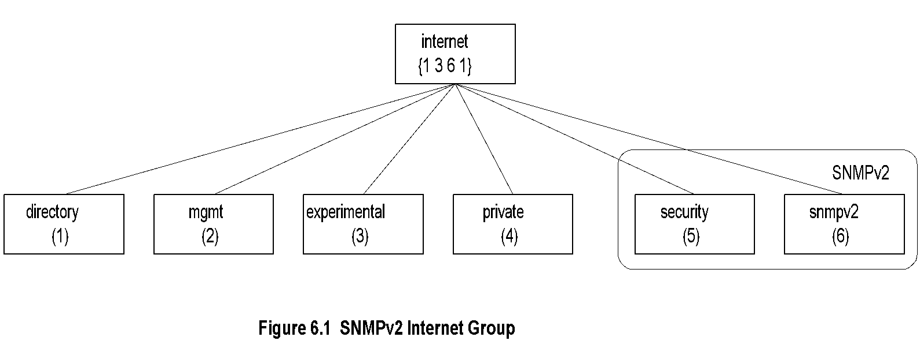
Chapter 6 SNMP Management: SNMPv2
SNMPv2 Internet Group
Notes
Objects added to System group
Extensive modification of the SNMP group
Additional SNMPv2 group added
Security group is a placeholder

Slide 7
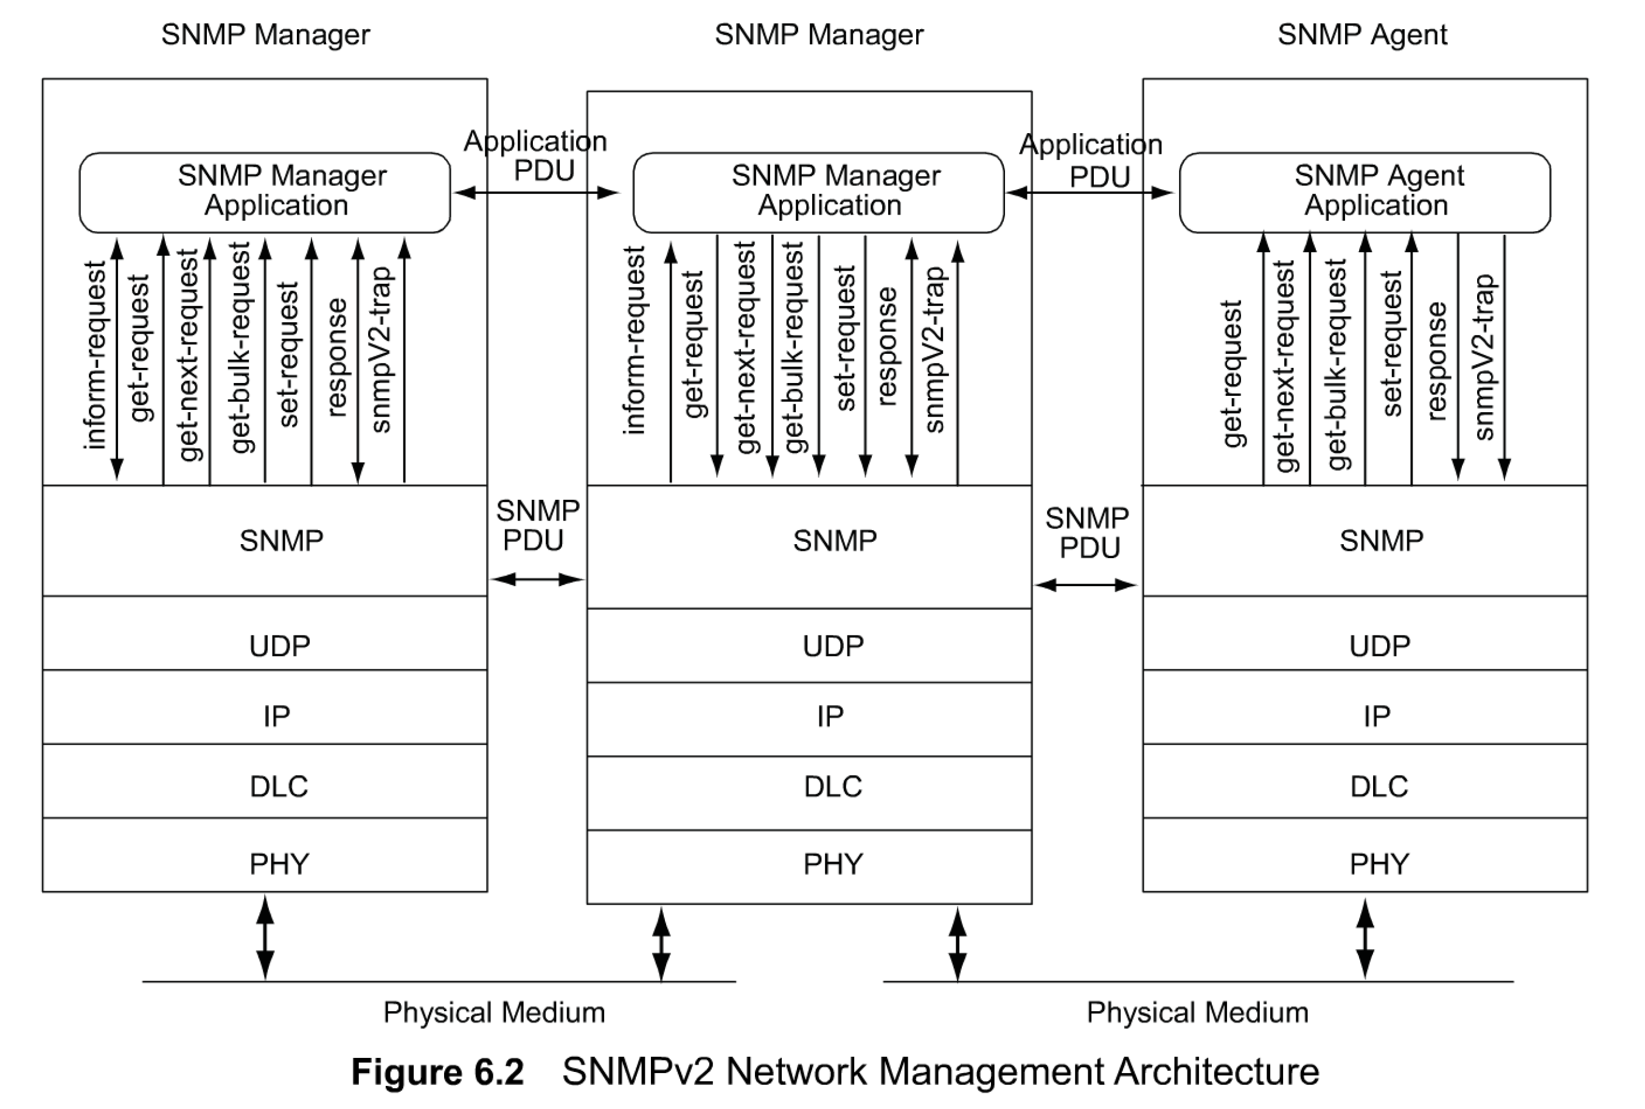
Chapter 6 SNMP Management: SNMPv2
SNMPv2 NM Architecture

Slide 8
SNMPv2 SYSTEM ARCHITECTURE
there are two significant enhancements in SNMPv2 architecture. First, there are seven messages instead of five.
Second, two manager applications can communicate with each other at the peer level. Another message, report message, is missing from Figure 6.2. It is not currently being used and is hence omitted from the figure.
The messages get-request, get-next request, and set-request are the same as in version 1 and are generated by the manager application. The message, response is the same as get-response in version 1, and is now generated by both agent and manager applications. It is generated by the agent application in response to a get or set message from the manager application. It is also generated by the manager application in response to an inform-request message from another manager application.
An inform-request message is generated by a manager application and is transmitted to another manager application. As mentioned above, the receiving manager application responds with a response message. This set of communication messages is a powerful enhancement in SNMPv2, since it makes two network management systems interoperable.
The message get-bulk-request is generated by manager application. Its used to transfer large amounts of data from the agent to the manager, especially if it includes retrieval of table data. The retrieval is fast and efficient. The receiving entity generates and fills data for each entry in the request and transmits all the data as a response message back to the originator of the request.
An SNMPv2-trap event, known as trap in version 1 ,is generated and transmitted by an agent process when an exceptional situation occurs. The destination to which it is sent is implementation-dependent. The PDU structure has been modified to be consistent with other PDUs.
Another enhancement in SNMPv2 over version 1 is the mapping of the SNMP layer over multiple transport domains. An example of this is shown in Figure 6.3, in which an SNMPv2 agent riding over a connectionless OSI transport layer protocol, Connectionless-Mode Network Service (CLNS), communicates with an SNMPv2 manager over the UDP transport layer. RFC 1906, which describes transport mappings, addresses a few well-known transport layer mappings:; others can be added using a similar structure.
Details on the MIB relating to SNMPv2 are covered in Section 6.4 and communication protocol aspects of messages in Section 6.5. Although not a standard, RFC 1283 specifies SNMP over Connection Oriented Transport Service (COTS), a connection-oriented OSI transport protocol. However, SNMP is not specified over connection-oriented Internet protocol, TCP.

Slide 9
Chapter 6 SNMP Management: SNMPv2
SNMPv2 New Messages
inform-request
manager-to-manager message
get-bulk-request
transfer of large data
report
not used
Notes

Slide 10
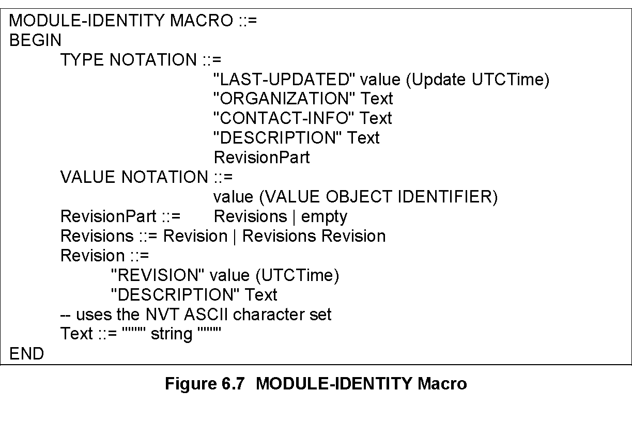
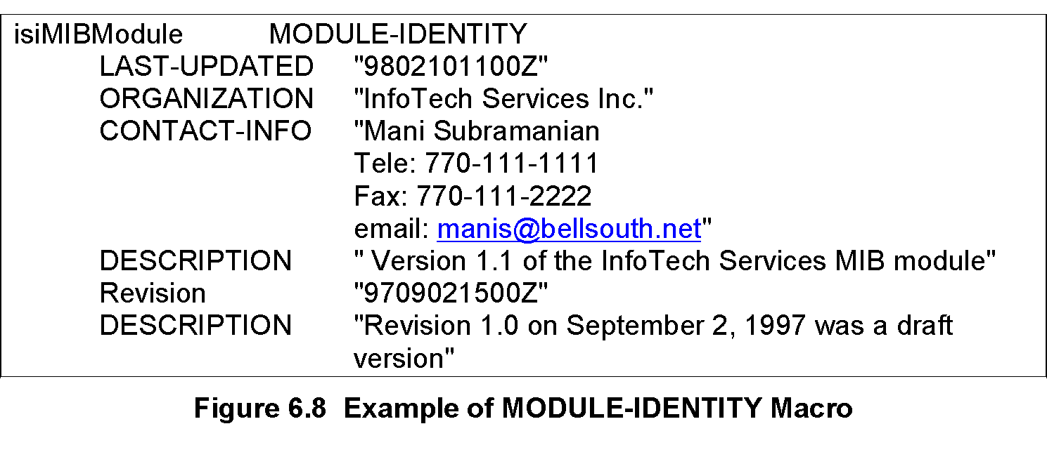
Chapter 6 SNMP Management: SNMPv2
Module Identity Macro
Notes
Module is a group of related assignments
MODULE-IDENTITY macro defines the module definitions
Notes:
*

Slide 11
Chapter 6 SNMP Management: SNMPv2
OBJECT ??
OBJECT IDENTIFIER defines the administrative identification of a node in the MIB
OBJECT-IDENTITY macro assigns an object identifier to an object identifier in the MIB
OBJECT-TYPE macro defines the type of a managed object
Notes

Slide 12
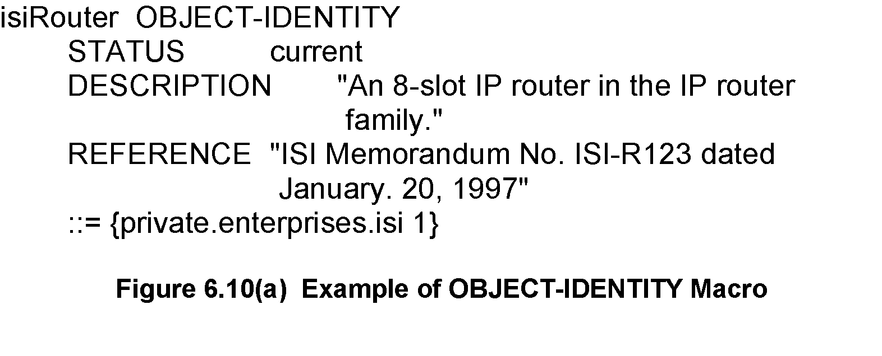
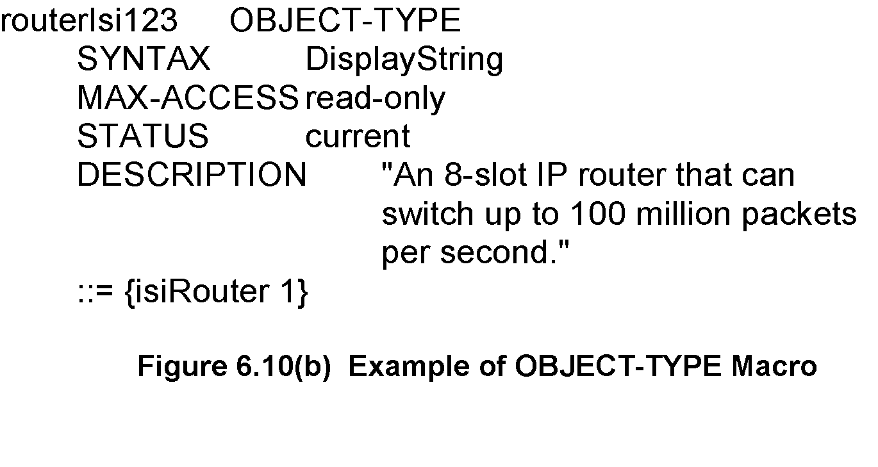
Chapter 6 SNMP Management: SNMPv2
OBJECT-IDENTITY / OBJECT-TYPE
OBJECT-IDENTITY is high level description
OBJECT-TYPE details description needed for implementation
-
© Mani Subramanian 2010
*

Slide 13
Chapter 6 SNMP Management: SNMPv2
Table Expansion
Table Expansion:
Augmentation of a table (dependent table) adds additional columns to an existing table (base table)
Dense table enables addition of more rows to base table
Sparse table supplements less rows to a base table
Notes

Slide 14
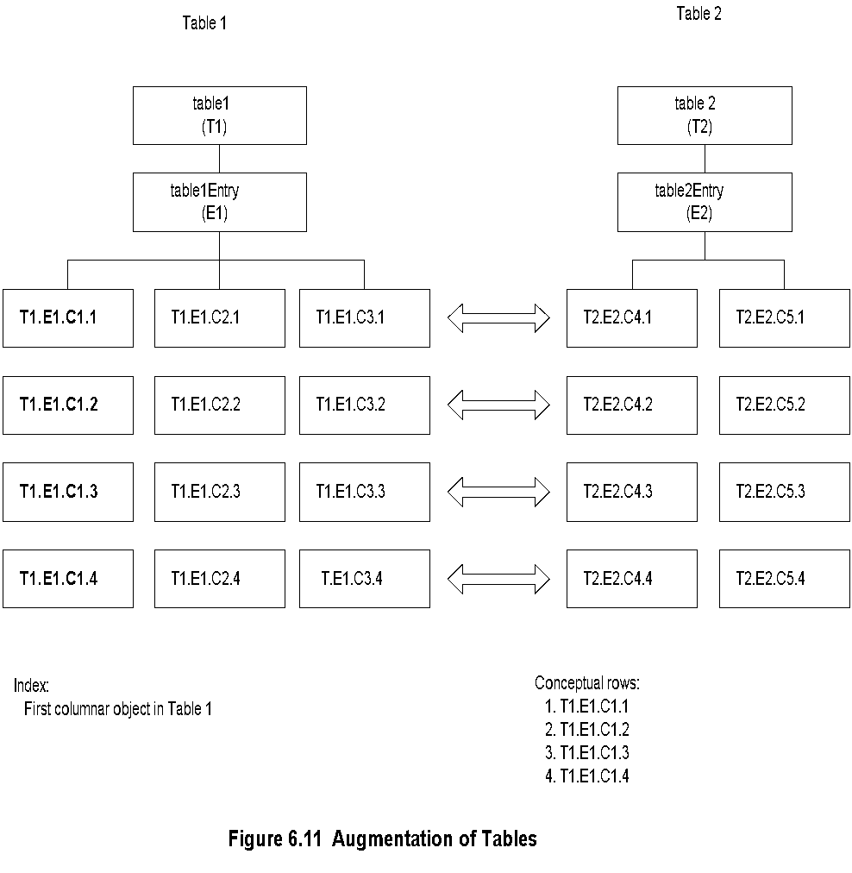
Chapter 6 SNMP Management: SNMPv2
Augmentation of Tables
Augmentation of a table (dependent table) adds additional columns to an existing table (base table)

Slide 15
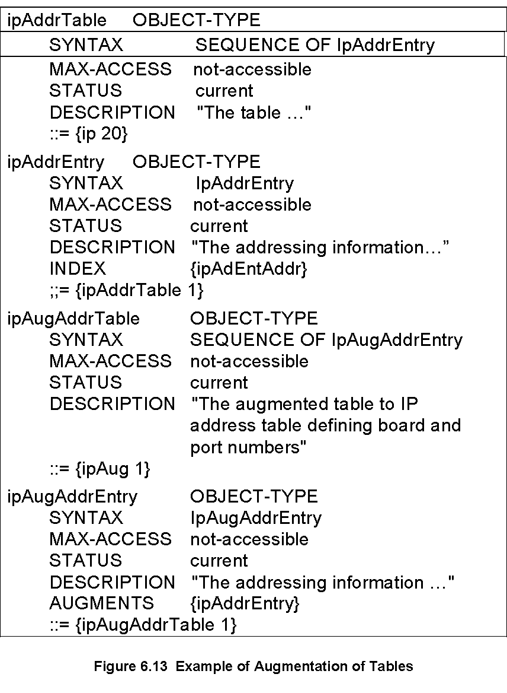
Chapter 6 SNMP Management: SNMPv2
Augmentation of Tables: Example

Slide 16
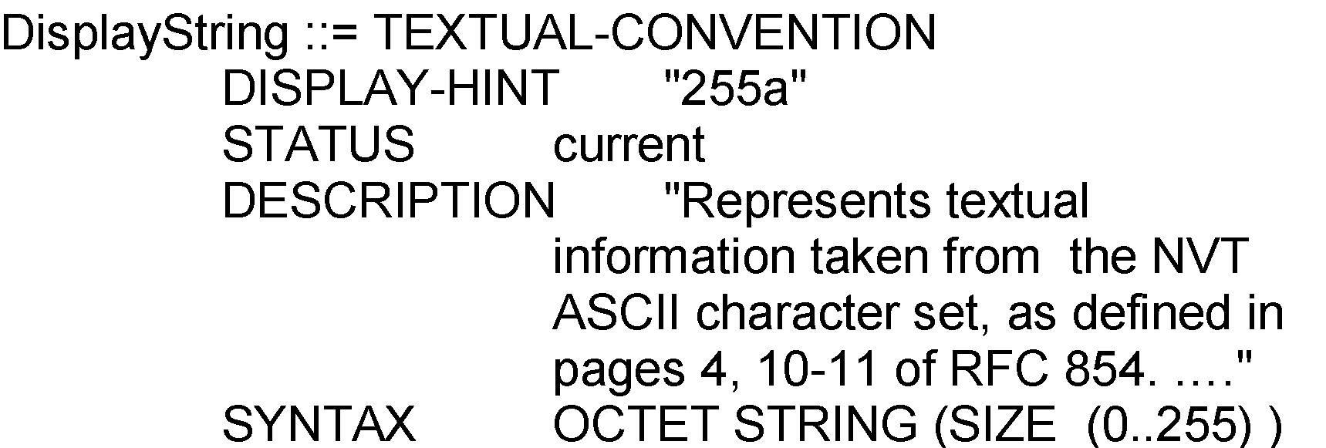
Chapter 6 SNMP Management: SNMPv2
Textual Convention
Enables defining new data types
Makes semantics of data types consistent and human readable
Creates new data types using existing ones and applies restrictions to them
An important textual convention in SNMPv2, RowStatus creates and deletes rows
Notes
SNMPV1:
SNMPv2:

Slide 17
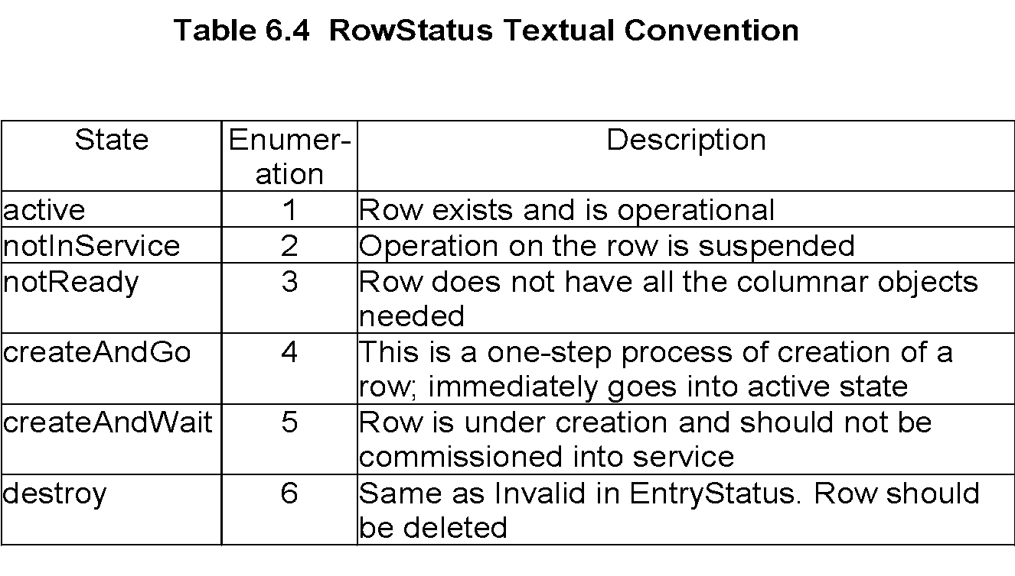
Chapter 6 SNMP Management: SNMPv2
Creation of Row: RowStatus
Notes
Status: A new column is added to the conceptual table
SYNTAX of Status is RowStatus
Value of RowStatus is Enumerated معدود INTEGER

Slide 18
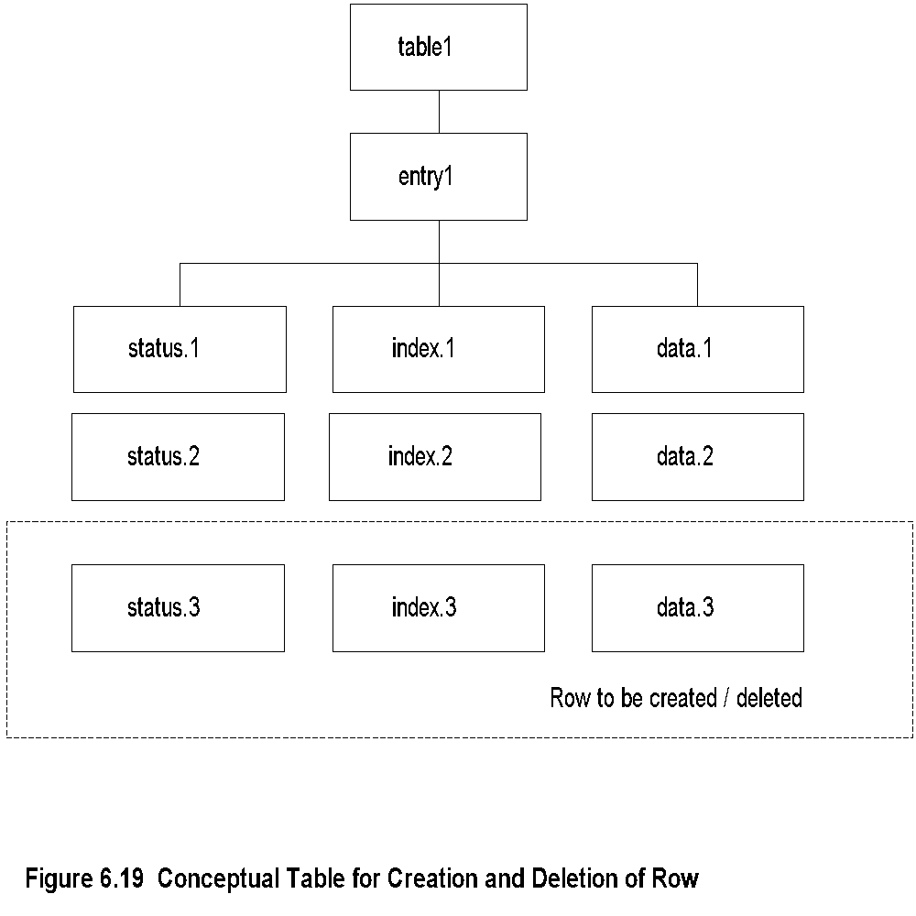
Chapter 6 SNMP Management: SNMPv2
Row Creation and Deletion
The creation of a row and deletion of a row are significant new features in SMIv2.
There are two methods to create a row in a table. The first is to create a row and make it active, which is available immediately. The second method is to create the row and make it available at a later time. This means that we need to know the status of the row as to its availability.
The information on the status of the row is accomplished by introducing a new column, called the status column.
RowStatus is used as the value of the SYNTAX clause for the status column of a conceptual row. Table 6.4 shows the status with enumerated integer syntax for the six states associated with the row status. The last three states, along with the first one ( 1 ,4, 5, and 6), are those that the manager uses to create or delete rows on the agent.
As we notice from Table 6.4, there are two states for RowStatus, createAndGo and createAndWait, which are action operations.
Figure 6.20 shows the Create-and-Go operation. The manager process initiates a Set-Request-PDU to create a conceptual row with the values given for the three columnar instances of the row. The value for the index column is specified by the VarBind index = 3. This is suffixed to the other two columnar objects in the new row to be created. The value of status is specified as 4, which is the createAndGo state as seen in Table 6.4.
Notes

Slide 19
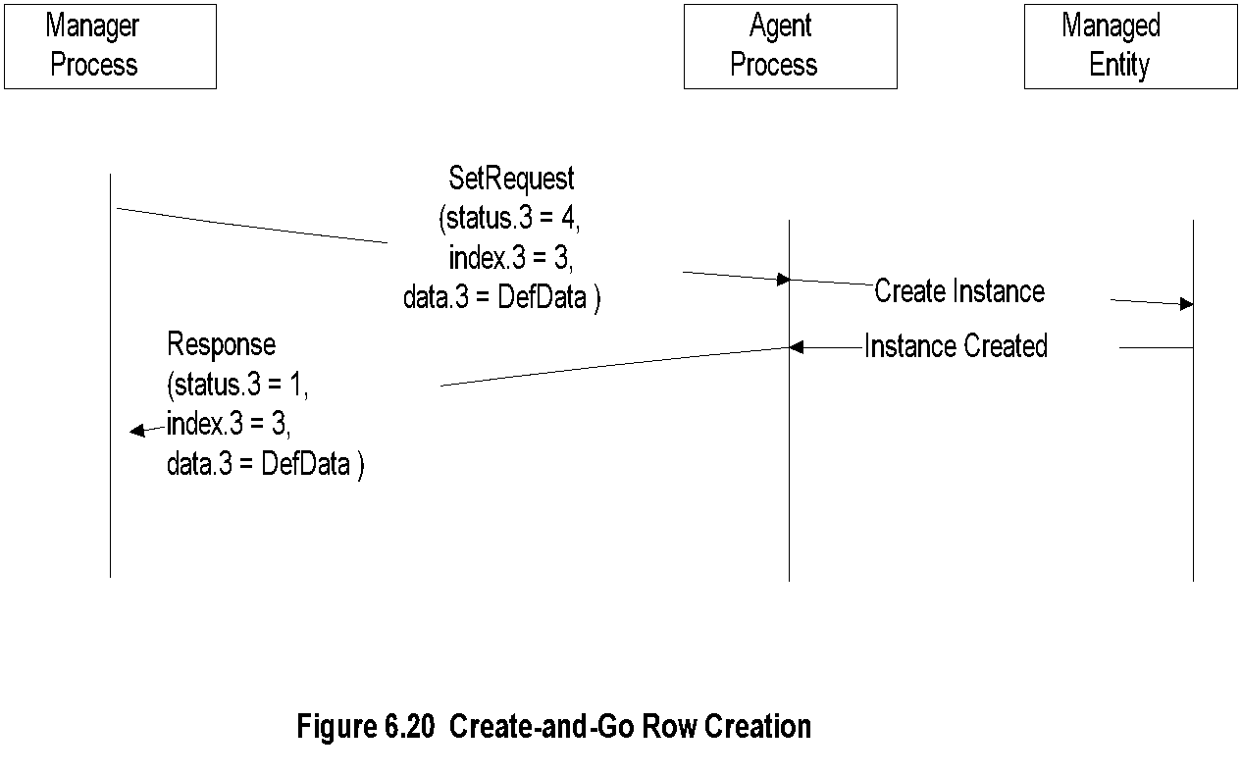
Chapter 6 SNMP Management: SNMPv2
Create-and-Go Row Creation

Slide 20
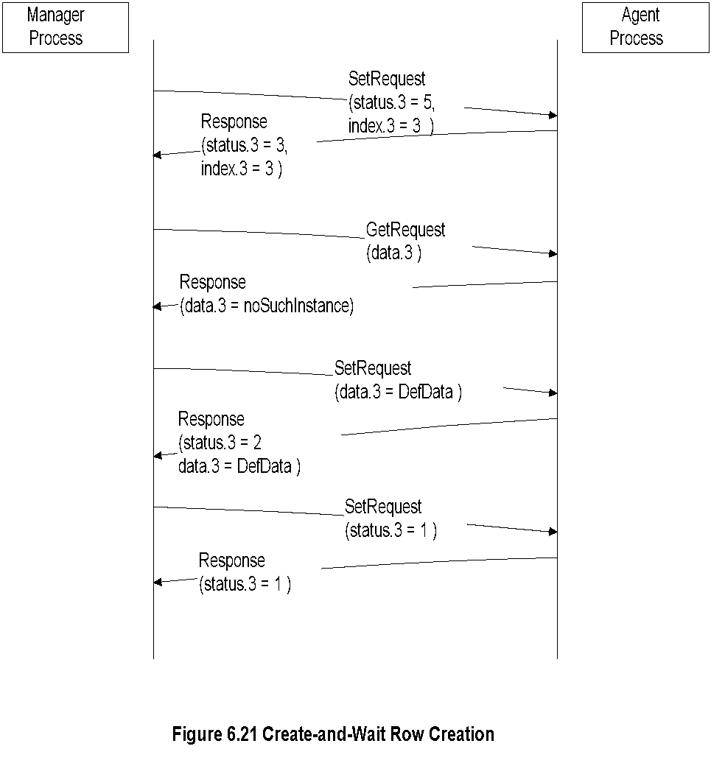
Chapter 6 SNMP Management: SNMPv2
Create-and-Wait: Row Creation

Slide 21
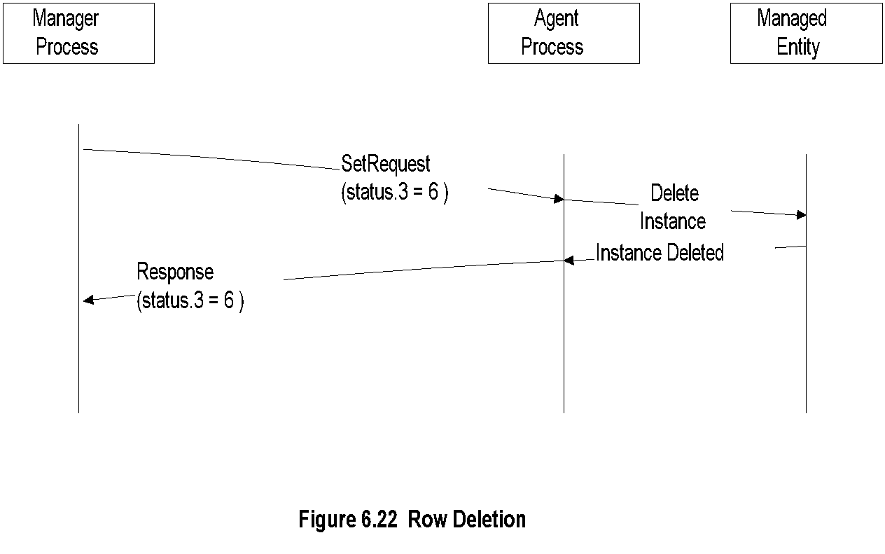
Chapter 6 SNMP Management: SNMPv2
Row Deletion
-
© Mani Subramanian 2010
*

Slide 22
Chapter 6 SNMP Management: SNMPv2
Create-and-Wait: Row Creation
Creation of Row: RowStatus
Notes
Status: A new column is added to the conceptual table
SYNTAX of Status is RowStatus
Value of RowStatus is Enumerated معدود INTEGER
Row Deletion
Create-and-Go Row Creation

Slide 23
Chapter 6 SNMP Management: SNMPv2
Major Changes in SNMPv2
Table Expansion:
Augmentation of a table (dependent table) adds additional columns to an existing table (base table)
Dense table enables addition of more rows to base table
Sparse table supplements less rows to a base table
Bulk data transfer
Manager-to-manager message
New Messages
Enhancements to SMI: SMIv2
Module definitions: MODULE-IDENTITY macro
Object definitions: OBJECT-TYPE macro
Trap definitions: NOTIFICATION-TYPE macro
Textual conventions (Enables defining new data types)
Conformance statements
Row creation and deletion in table (RowStatus )
MIB enhancements
Transport mappings
inform-request
manager-to-manager message
get-bulk-request
transfer of large data
report
not used
Notes
Security features, originally to be in SNMPv2 moved to SNMPv3
SNMPv2, like SNMPv1, is community-based administrative framework

Slide 24
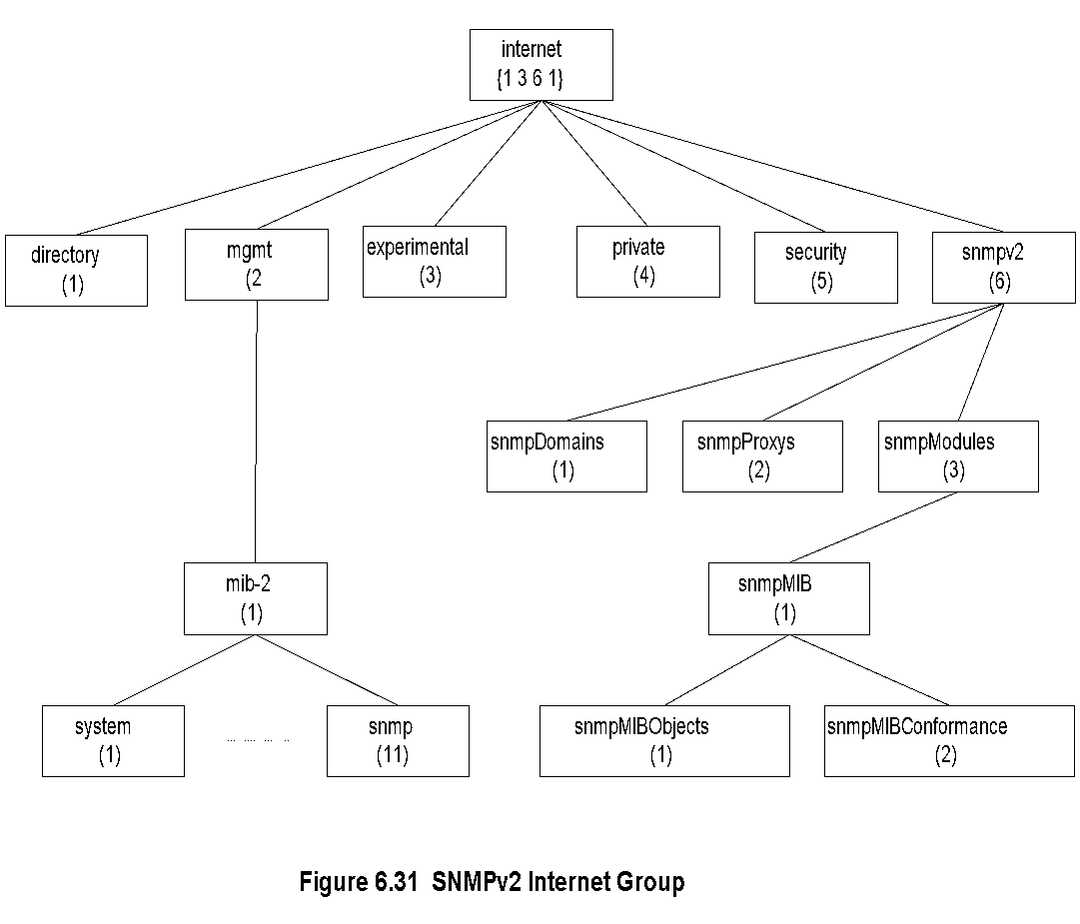
Chapter 6 SNMP Management: SNMPv2
SNMPv2 MIB
As mentioned in Section 6.2 and shown in Figure 6.5 two new MIB modules, security and SNMPv2, have been added to the Internet MIB.
The SNMPv2 module has three submodules: snmpDomains, snmpProxys, and snmpModules.
snmpDomains extends the SNMP standards to send management messages over transmission protocols other than UDP.
Notes
Security is a placeholder النائب
System group: A table sysORTable added that lists resources that the agent controls; NMS configures NE through the agents.
Most of the objects in the SNMPv1 obsoleted
Object Groups and Notification Groups defined for conformance specifications.
التوافق او التطابق

Slide 25
Chapter 6 SNMP Management: SNMPv2
Conformance: OBJECT-GROUP
Conformance defined by التوافق يحددها
OBJECT-GROUP macro
NOTIFICATION-GROUP macro
OBJECT-GROUP
Compiled during implementation, not at run time
OBJECTS clause names each object
Every object belongs to an OBJECT-GROUP
Access defined by MAX-ACCESS, the maximum access privilege for the object
Notes

Slide 26
Chapter 6 SNMP Management: SNMPv2
Conformance: NOTIFICATION-GROUP
NOTIFICATION-GROUP
Contains trap entities defined in SMIv1
NOTIFICATIONS clause identifies the notifications in the group
NOTIFICATIONS-GROUP macro compiled during implementation, not at run time
Notes

Slide 27
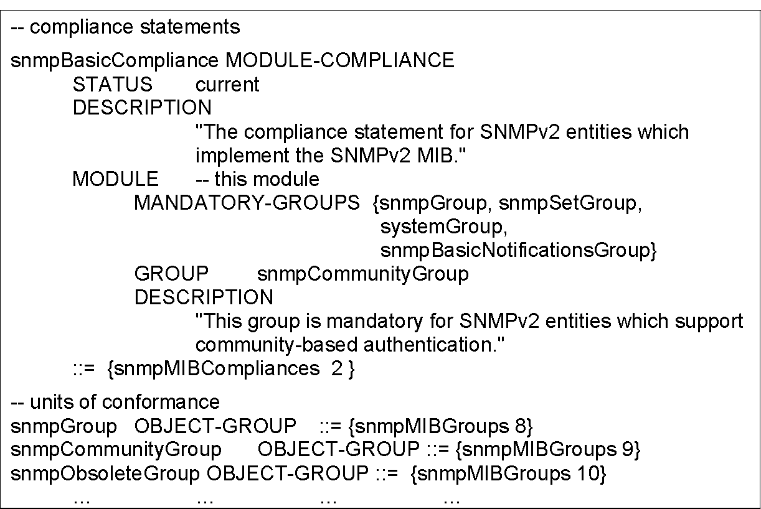
Chapter 6 SNMP Management: SNMPv2
Compliance الالتزام او الامتثال
Compliance has two classes of groups
MANDATORY-GROUPS ... Required
GROUP …Optional
Notes

Slide 28
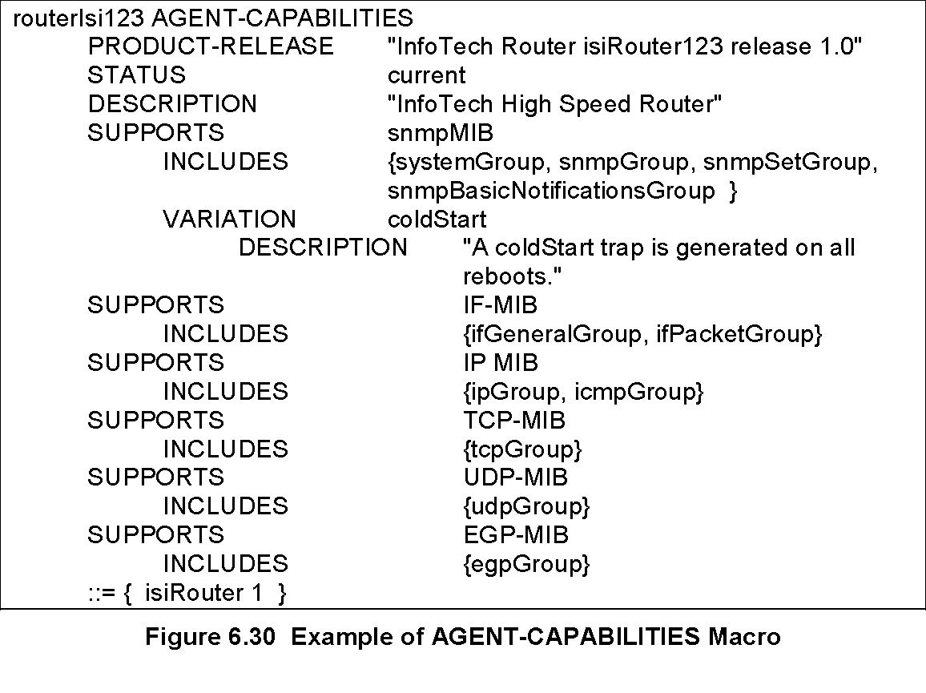
Chapter 6 SNMP Management: SNMPv2
Agent Capabilities
AGENT-CAPABILITIES macro
SUPPORTS modules and includes groups
VARIATION identifies additional features
Notes

Slide 29
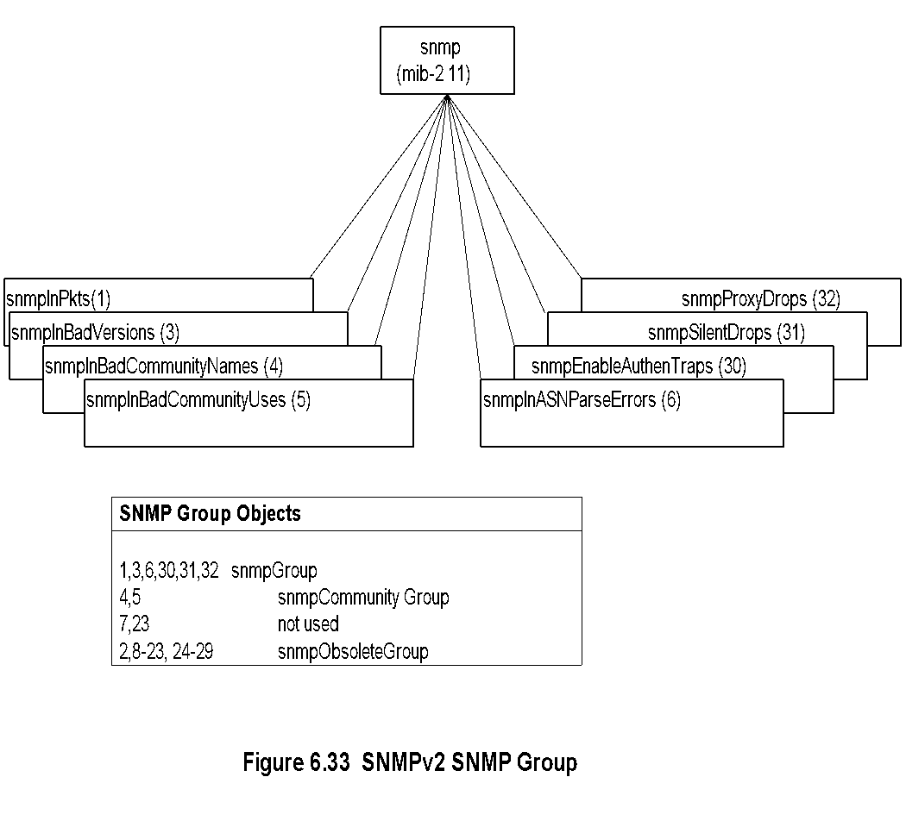
Chapter 6 SNMP Management: SNMPv2
SNMPv2 SNMP MIB
Notes
Compare this to SNMPv1 MIB!
-
© Mani Subramanian 2010
*

Slide 30
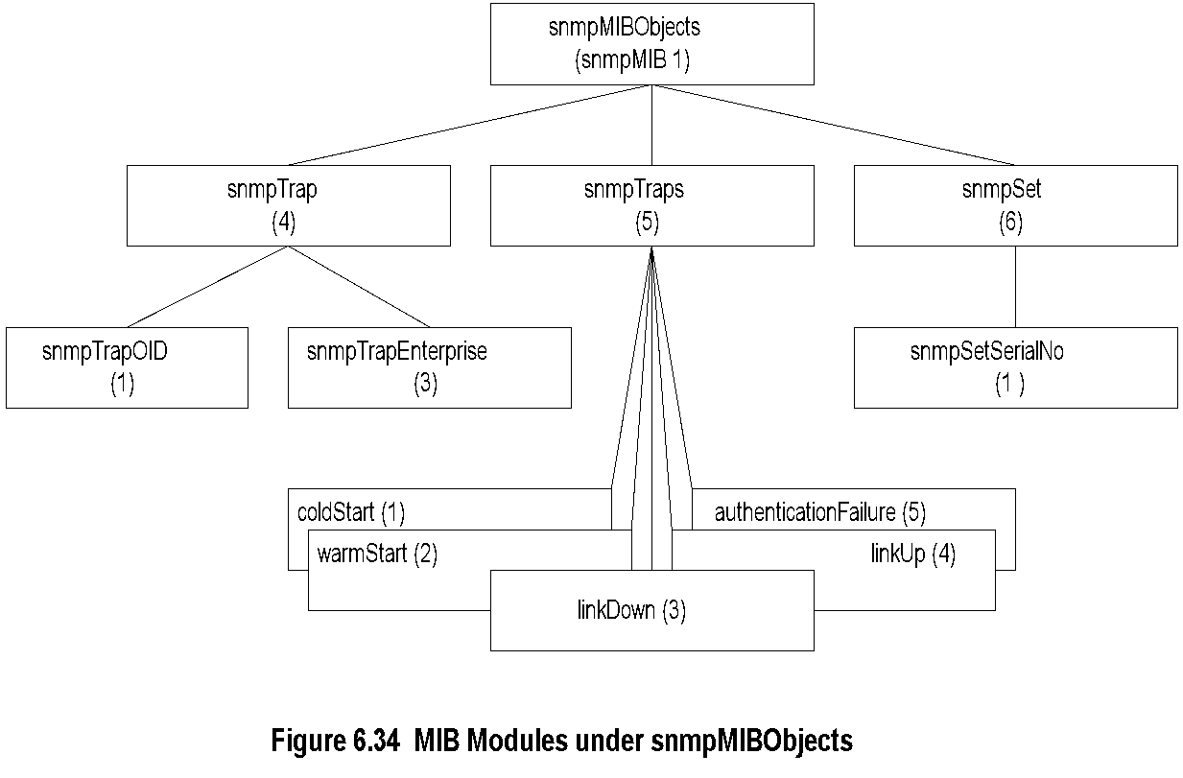
Chapter 6 SNMP Management: SNMPv2
snmpMIBObjects MIB
Notes
-
© Mani Subramanian 2010
*

Slide 31
Chapter 6 SNMP Management: SNMPv2
SNMPv2 PDU
Notes
Standardized format for all messages
Interpretation of error status and error index fields; In v1, if error occurs status and index field filled, but varBindList blank
Interpretation in v2 Status Index
varBindList ignored x
varBind of index field ignored x x

Slide 32
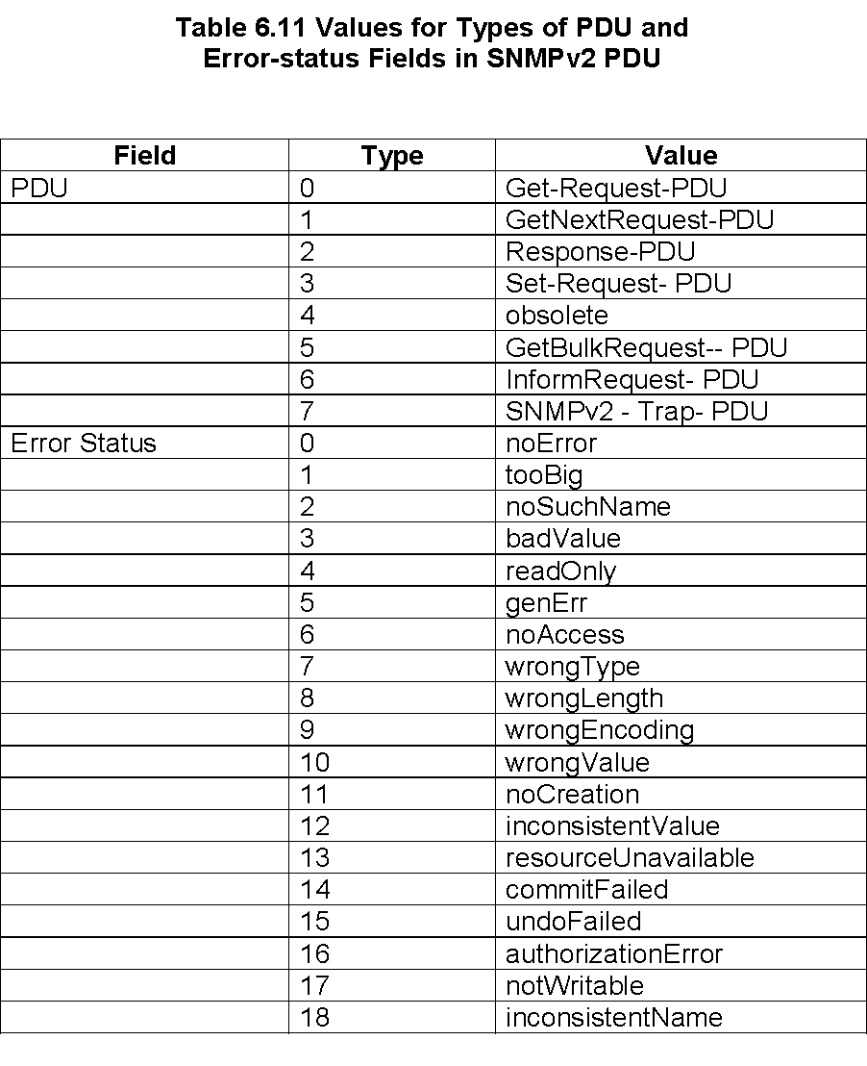
Chapter 6 SNMP Management: SNMPv2
SNMPv2 PDU and Error Status

Slide 33
Chapter 6 SNMP Management: SNMPv2
SNMPv2 GetBulkRequest PDU
SNMPv2 Protocol Operations
There are seven protocol operations in SNMPv2, as discussed in Section 6.2.
The two additional messages that are in SNMPv2, which are not in version 1, are the GetBulkRequest and InformRequest. The command, get-bulk-request, is an enhancement of get-next request and retrieves data in bulk efficiently.
GetBulkRequest PDU Operation
The get-bulk-request operation is added in SNMPv2 to retrieve bulk data from a remote entity. Its greatest benefit is in retrieving multiple rows of data from a table. The basic operation of get-bulk-request is the same as get-next-request.
The third and fourth field positions are used in get-bulk-request message PDU as non-repeaters and max-repetitions, as shown in Figure 6.38. The non-repeaters field indicates the number of non-repetitive (scalar) objects to be retrieved. The max-repetitions field defines the maximum number of instances to be returned in the response message.
This would correspond to the number of rows in an aggregate object. The value for the max-repetitions field is operation-dependent and is determined by such factors as the maximum size of the SNMP message, or the buffer size in implementation, or the expected size of the aggregate object table.
The data structure of the response for the get-bulk-request operation differs from other get and set operations. Successful processing of the get-bulk-request produces variable bindings (larger array of Var- BindList) in the response PDU, which is larger than that contained in the corresponding request. Thus, there is no one-to-one relationship between the VarBindList of the request and response messages.
Notes
Error status field replaced by Non-repeaters
Error index field replaced by Max repetitions
No one-to-one relationship between request and response

Slide 34
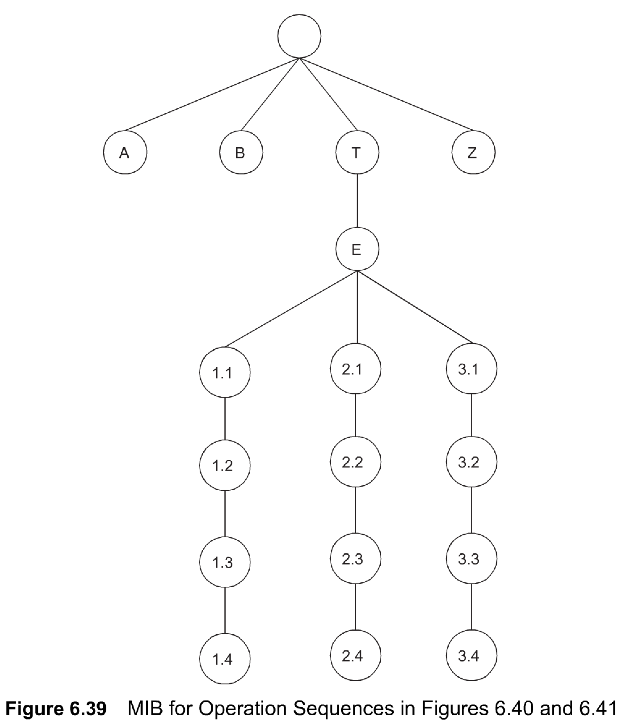
Chapter 6 SNMP Management: SNMPv2
Get-Bulk-Request: Generic MIB
Figure 6.39
shows a conceptual MIB to illustrate the operation of get-next-request and get-bulk-request shown in Figure 6.40 and Figure 6.41.
It is similar to Figure 5.12 with two additional rows added to the table. To notice the difference in improvement of get-bulk-request over get-next-request, let us look at Figure 6.40, which shows the sequence of operations for get-next-request for the MIB shown in Figure 6.39.

Slide 35
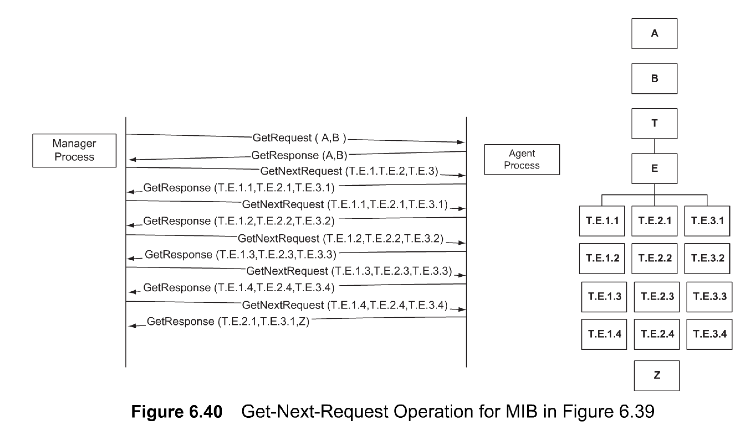
Chapter 6
Get-Next-Request Operation
The sequence starts with a get-request message from the manager process with a VarBindList array of two scalar variables A and B. It is subsequently followed by the get-next-request message with three columnar OBJECT IDENTIFIERS T.E. 1,T.E.2, and T.E.3. The get-response returns the first instance values T.E.1.1, T.E.2. 1, and T.E.3.1.
The sequence of operation continues until the fourth instance is retrieved. The last get-next-request message with the OBJECT IDENTIFIERS T.E. 1 .4, T.E.2.4, and T.E.3.4 generates the values T.E.2.1, T.E.3.1, and Z. This is because there are no more instances of the table. It retrieves the three objects, which are logically the next lexicographically higher objects—namely T.E.2. 1 (next to T.E. 1.4),T.E.3. 1 (next to T.E.2.4), and Z (next to T.E.3.4). The manager would stop the sequence at this message. However, if it continues the operation, it would receive a noSuchName error message.

Slide 36
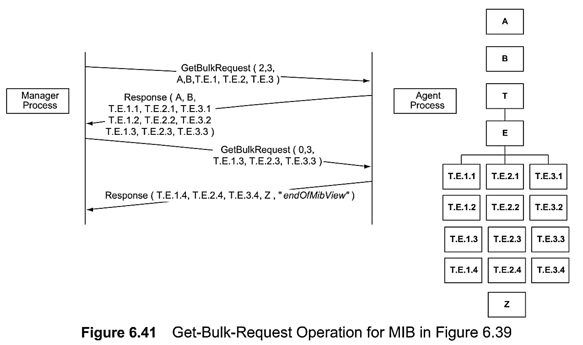
Chapter 6
Get-Bulk-Request Operation
Get-Next-Request Operation
The sequence starts with a get-request message with a VarBindList array of two scalar variables A and B. followed by the get-next-request message with three columnar OBJECT IDENTIFIERS T.E. 1,T.E.2, and T.E.3.
The get-response returns the first instance values T.E.1.1, T.E.2. 1, and T.E.3.1.
The sequence of operation continues until the fourth instance is retrieved. Using lexicographically order. The manager would stop the sequence at this message. However, if it continues the operation, it would receive a noSuchName error message.
The entire MIB data are retrieved in two requests. The first message GetBulkRequest (2, 3, A, B, T.E.I, T.E.2, T.E.3 ) is a request for receiving two non-repetitive objects (the first variable (2) in the request command) and three repetitive instances (the second operand (3) in the command) of the columnar objects (T.E.1 ,T.E.2, and T.E.3).
The response returns values of A and B for the non-repetitive objects, and the first three rows of the aggregate object table. The second request is for three more rows of the table. Since there is only one more row left to send, the response message contains the information in the last row, the next lexicographic entity, Z, and the error message endOfMibView. The manager interprets this as end of the table.

Slide 37
Chapter 6 SNMP Management: SNMPv2
Get-Bulk-Request Operation
Figure 6.41 shows the sequence of operations to retrieve the MIB shown in Figure 6.39 using the get-bulk message. The entire MIB data are retrieved in two requests. The first message GetBulkRequest (2, 3, A, B, T.E.I, T.E.2, T.E.3 ) is a request for receiving two non-repetitive objects (the first variable (2) in the request command) and three repetitive instances (the second operand (3) in the command) of the columnar objects (T.E.1 ,T.E.2, and T.E.3).
The response returns values of A and B for the non-repetitive objects, and the first three rows of the aggregate object table. The second request is for three more rows of the table. Since there is only one more row left to send, the response message contains the information in the last row, the next lexicographic entity, Z, and the error message endOfMibView. The manager interprets this as end of the table.

Slide 38
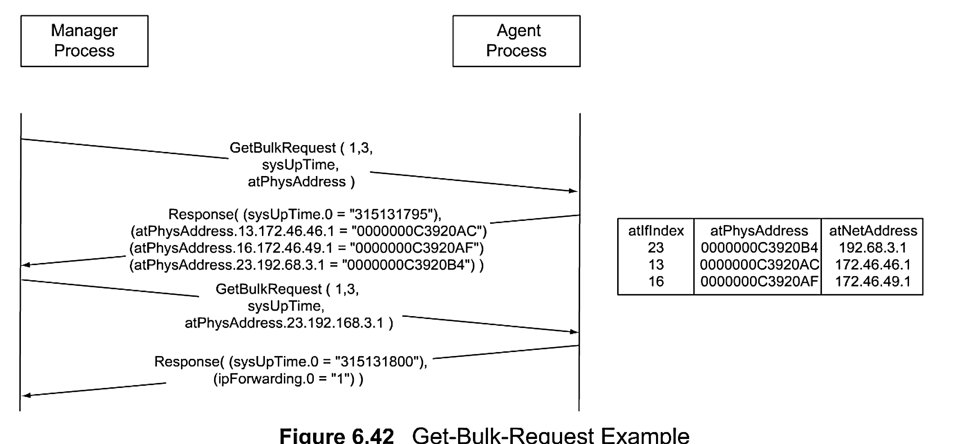
Chapter 6 SNMP Management: SNMPv2
Get-Bulk-Request Example
Figure 6.42 shows the retrieval of the Address Translation table shown in Figure 5.16 using the get-bulk-request operation. Instead of four sets of get-next-request and get-response messages, only two get-bulk-request and response messages are needed in the get-bulk-request operation.

Slide 39
Chapter 6 SNMP Management: SNMPv2
SNMPv2 Trap
Notes
Addition of NOTIFICATION-TYPE macro
OBJECTS clause, if present, defines order of variable bindings
Positions 1 and 2 in VarBindList are sysUpTime and snmpTrapOID

Slide 40
Chapter 6 SNMP Management: SNMPv2
Inform-Request
Figure 6.43 SNMPv2 Trap PDU
Notes
Inform-Request behaves as trap in that the message goes from one manager to another unsolicited
The receiving manager sends response to the sending manager

Slide 41
6.6 COMPATIBILITY WITH SNMPv1
An SNMP proxy server, in general, converts a set of non-SNMP entities into a set of SNMP-defined MIB entities. Unfortunately, SNMPv2 MIB is not backward compatible with SNMPvl and hence requires conversion of messages. SNMPv2 has two schemes for migration from SNMPvl to SNMPv2: bilingual manager and SNMP proxy server.
Bilingual Manager
One of the migration paths to transition to SNMPv2 from version 1 is to implement both SNMPvl and SNMPv2 interpreter modules in the manager with a database that has profiles of the agents' version.
The interpreter modules do all the conversions of MIB variables and SNMP protocol operations in both directions. The bilingual manager does the common functions needed for a management system.
The SNMP PDU contains the version number field to identify the version (see Figure 5.5). This arrangement is shown in Figure 6.45. This is expensive to implement and maintain. The alternative scheme is to use a proxy server.
SNMP Proxy Server
The SNMPv2 proxy server configuration is shown in Figure 6.46. The requests to and responses from, as well as traps from, SNMPv2 agents are processed by the SNMPv2 manager with no changes.
A proxy server is implemented as a front-end module to the SNMPv2 manager for communication with SNMPvl agents.
Figure 6.47 details the conversions that are done by an SNMP v2-vl proxy server. The get-Request, GetNextRequest-PDU, and Set-Request-PDU from the SNMPv2 manager are passed through unaltered by the proxy server.
There are two modifications done to the GetBulkRequest PDU.
The values for the two fields, non-repeaters and max-repetitions, are set to zero and transmitted as GetNextRequest PDU.
The GetResponse from SNMPvl is passed through unaltered by the proxy server to the SNMPv2 manager, unless a response has a tooBigError value. In the exception case, the contents of the variable-binding field are removed before propagating the response. The trap from the SNMPvl agent is prepended with two VarBind fields, sysUpTime.0 andsnmpTrapOID.0,with their associated values and then passed on to the SNMPv2 manager as SNMPv2-Trap PDU.

Slide 42
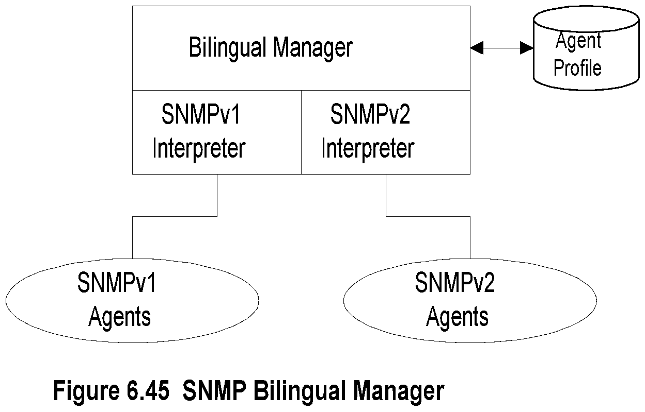
Chapter 6 SNMP Management: SNMPv2
ثنائي اللغة Bilingual Manager
Notes
Compatibility with SNMPv1
Bilingual Manager
Proxy Server
Bilingual Manager expensive in resource and operation

Slide 43
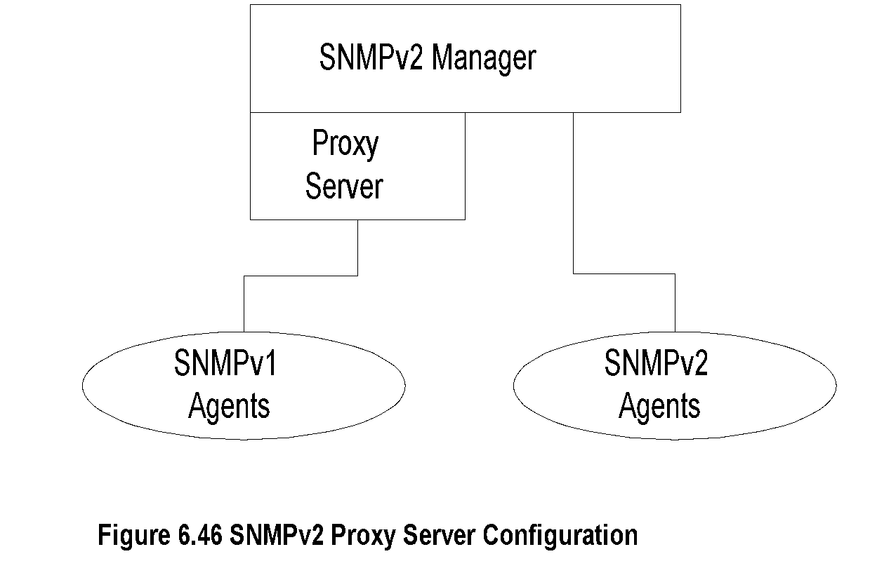
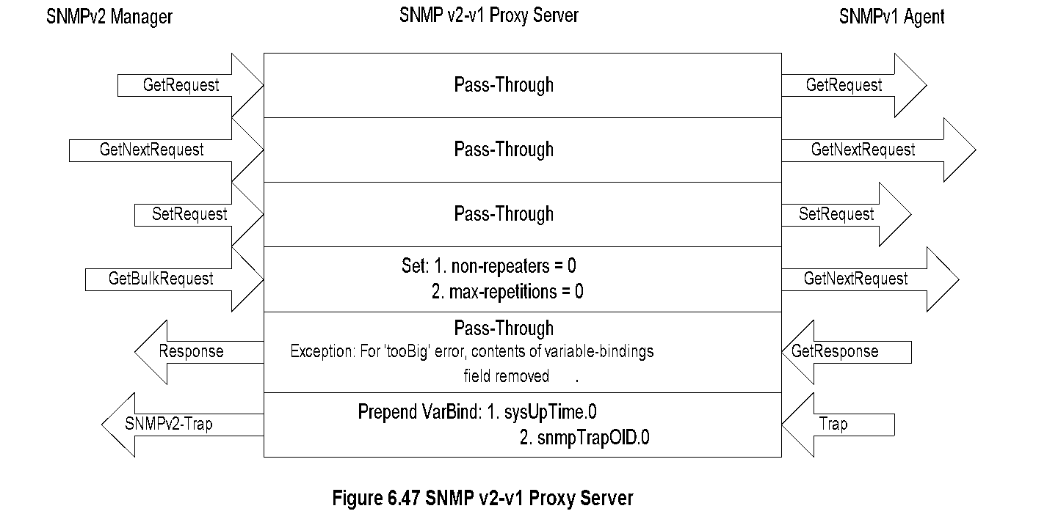
Chapter 6 SNMP Management: SNMPv2
SNMP Proxy Server

Slide 44
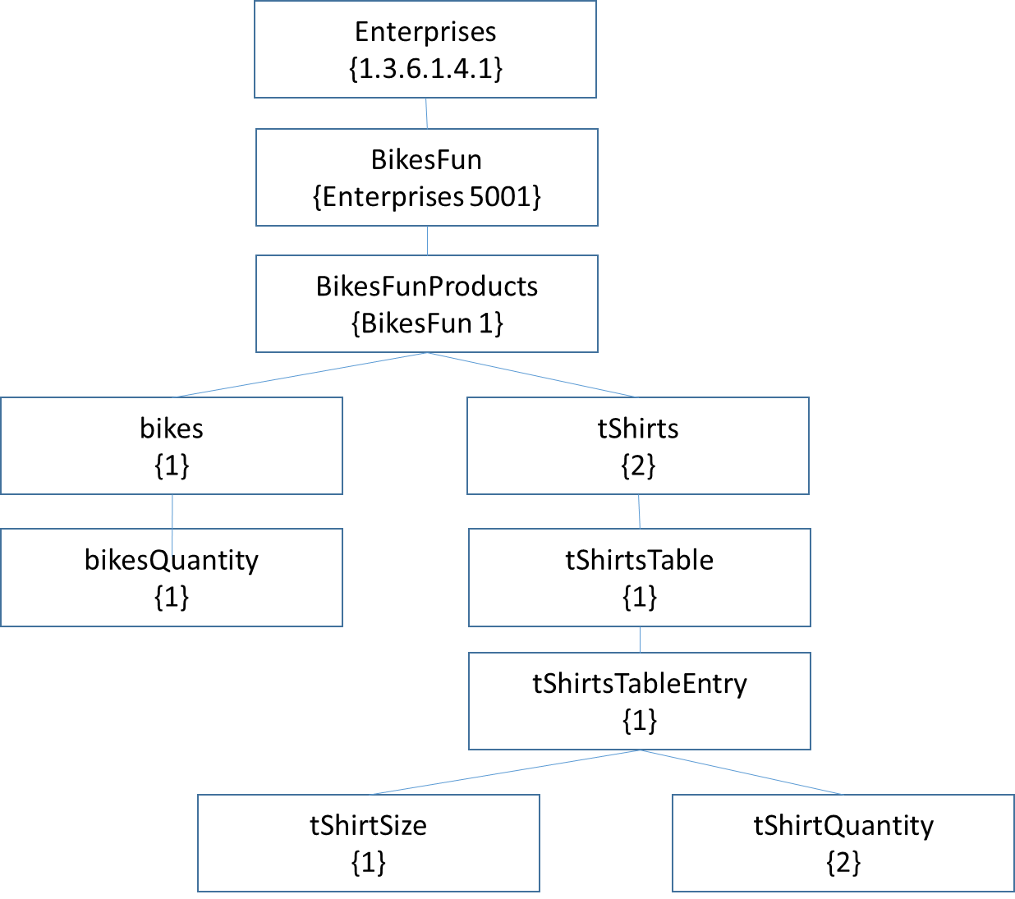
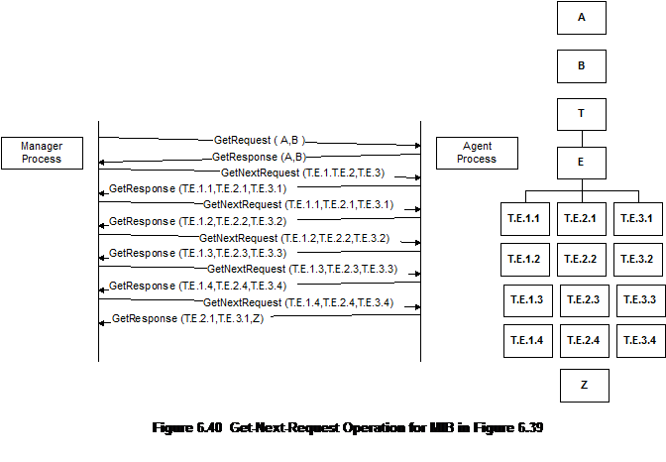
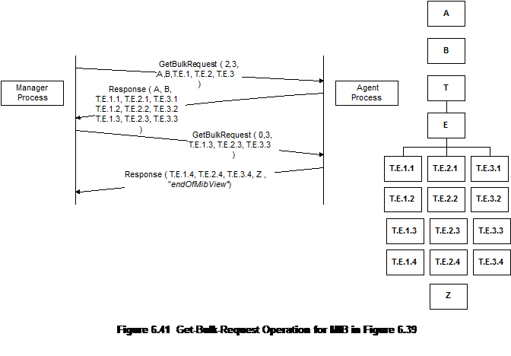
Assignment 02 Q1
Suppose the following MIB for a certain enterprise BikesFun selling bikes and t-shirts.
Draw request-response messages, as shown in figures 6.40 and 6.41 (chapter 6), to retrieve all columnar objects of the following table:
tShirtSize | tShirtQuantity
10 | 50
12 | 100
14 | 150
16 | 250
18 | 200
Provide responses when:
(a) using get-next –request and response
(b)Using get-bulk- request and response
Then compare
Answer next slide

Slide 45
Suppose the following MIB for a certain enterprise selling t-shirts.
to retrieve all columnar objects of the following table:
Solution:
<Enterprises 5001> DEFINITIONS ::= BEGIN
Enterprises 5001 OBJECT IDENTIFIER ::= { enterprises 5000 }
-- Only Products group is defined in this module.
-- Products Group
abcProducts OBJECT IDENTIFIER ::= { Enterprises 5001 }
-- the Products group
tShirt OBJECT-TYPE
SYNTAX DisplayString (SIZE (10, 12, 14, 16, 18))
ACCESS read-only
STATUS mandatory
DESCRIPTION " tShirt are all made in one size and adjustable." ::= { Enterprises 5001Products 1 }
tShirt Quantity OBJECT-TYPE
SYNTAX INTEGER
ACCESS read-only STATUS mandatory
DESCRIPTION "Quantity of hats in the inventory." ::= { tShirt 1 }
END
Using get-next –request and response
GetnextRequest (at Enterprise ,tShirt, tShirtTable, tShirttableEntry, tShirtSize tshirtQuantity )
Getnextresponse (5001, 2, 1, 1, 10, 50 )
GetnextRequest (at Enterprise ,tShirt, tShirtTable, tShirttableEntry, tShirtSize tshirtQuantity )
Getnextresponse (5001, 2, 1, 1, 12, 100 )
GetnextRequest (at Enterprise ,tShirt, tShirtTable, tShirttableEntry, tShirtSize tshirtQuantity )
Getnextresponse (5001, 2, 1, 1, 14, 150 )
GetnextRequest (at Enterprise ,tShirt, tShirtTable, tShirttableEntry, tShirtSize tshirtQuantity )
Getnextresponse (5001, 2, 1, 1, 16, 250 )
GetnextRequest (at Enterprise ,tShirt, tShirtTable, tShirttableEntry, tShirtSize tshirtQuantity )
Getnextresponse (5001, 2, 1, 1, 18, 200 )
Using get-bulk- request and response
GetbulkRequest (at Enterprise ,tShirt, tShirtTable, tShirttableEntry, tShirtSize tshirtQuantity )
Response (5001, 2, 1, 1, 1,2)
GetbulkRequest (5001, 2, 1, 1, 1,2 )
Response (5001, 2, 1, 1, “10,12,14,16,18”, “50,100,150,250,200”)
tShirtSize | tShirtQuantity
10 | 50
12 | 100
14 | 150
16 | 250
18 | 200

